Slide 1
Session 20 : Multithreading
Module 4.3 : Android

Slide 2
Learning Objectives
At the end of the session successful participants will be able to
Describe multi-threading in android.
Describe Advantages and disadvantages of multithreading
Implement Handler‘s MessageQueue
Use Messages
Create multithreading app using The AsyncTask Class

Slide 3
Multithreading
Threads
A Thread is a concurrent unit of execution
A Process with multiple threads executing at same time

Slide 4
Multithreading
Threads
Thread has its own call stack for methods being invoked, their arguments and local variables.
Each virtual machine instance has at least one main Thread running when it is started; typically, there are several others for housekeeping.
The application might decide to launch additional Threads for specific purposes.

Slide 5
Multithreading
Threads
Threads in the same VM interact and synchronize by the use of shared objects and monitors associated with these objects.
There are basically two main ways of having a Thread execute application code.
One is providing a new class that extends Thread and overriding its run() method.
The other is providing a new Thread instance with a Run-able object during its creation.
In both cases, the start() method must be called to actually execute the new Thread.

Slide 6
Multithreading
Threads
Process 1
(Dalvik Virtual Machine 1)
Process 2
(Dalvik Virtual Machine 2)
Common Memory Resources
Common Memory Resources
Main Thread
Thread 2
Main Thread
Thread 1

Slide 7
Multithreading
Advantages of Multi-Threading
Threads share the process' resources but are able to execute independently.
Applications responsibilities can be separated:
Main thread runs UI, and
Slow tasks are sent to background threads
Threading provides an useful abstraction of concurrent execution.

Slide 8
Multithreading
Advantages of Multi-Threading
Particularly useful in the case of a single process that spawns multiple threads on top of a multiprocessor system. In this case real parallelism is achieved.
Consequently, a multithreaded program operates faster on computer systems that have multiple CPUs.

Slide 9
Multithreading
Disadvantages of Multi-Threading
Code tends to be more complex
Need to detect, avoid, resolve deadlocks

Slide 10
Multithreading
Android‘s Approach to Slow Activities
An application may involve a time-consuming operation, however we want the UI to be responsive to the user. Android offers two ways for dealing with this scenario:
Do expensive operations in a background service, using notifications to inform users about next step
Do the slow work in a background thread.
Interaction between Android threads is accomplished using (a) Handler objects and (b) posting Run-nable objects to the main view.

Slide 11
Multithreading
Handler Class
When a process is created for your application, its main thread is dedicated to running a message queue that takes care of managing the top-level application objects (activities, intent receivers, etc) and any windows they create.
You can create your own secondary threads, and communicate back with the main application thread through a Handler.
When you create a new Handler, it is bound to the message queue of the thread that is creating it --from that point on, it will deliver messages and runnables to that message queue and execute them as they come out of the message queue.

Slide 12
Multithreading
Handler Class
There are two main uses for a Handler:
To schedule messages and runnables to be executed as some point in the future; and
To enqueue an action to be performed on another thread

Slide 13

Multithreading
Threads And UI
Warning
Background threads are not allowed to interact with the UI.
Only the main process can access the (main) activity’s view.
(Global) class variables can be seen and updated in the threads.

Slide 14
Multithreading
Handler‘s MessageQueue
A secondary thread that wants to communicate with the main thread must request a message token using the obtainMessage() method.
Once obtained, the background thread can fill data into the message token and attach it to the Handler’s message queue using the sendMessage() method.

Slide 15
Multithreading
Handler‘s MessageQueue
The Handler uses the handleMessage() method to continuously attend new messages arriving to the main thread.
A message extracted from the process’ queue can either return some data to the main process or request the execution of runnable objects through the post() method.

Slide 16
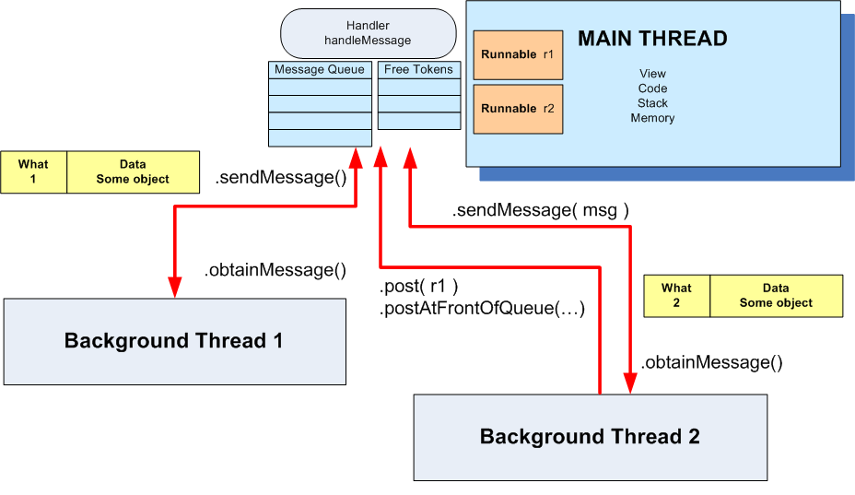
Multithreading
Handler‘s MessageQueue

Slide 17
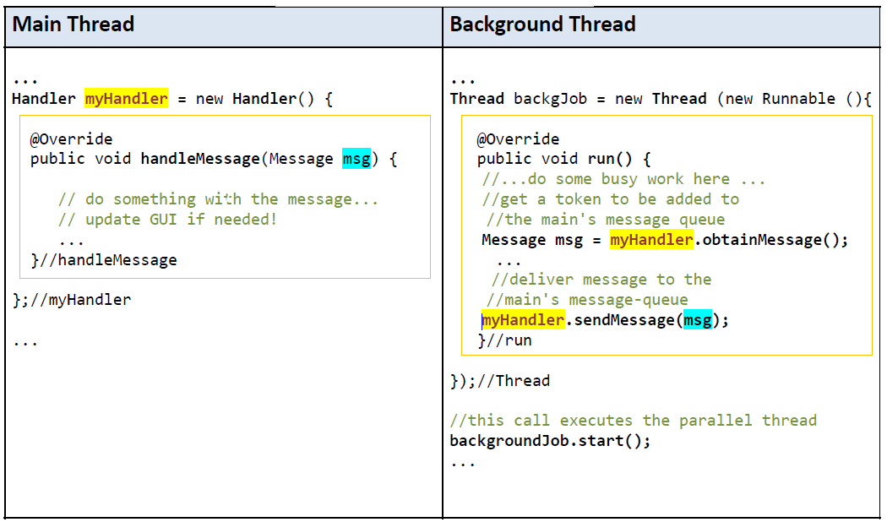
Multithreading
Using Messages

Slide 18
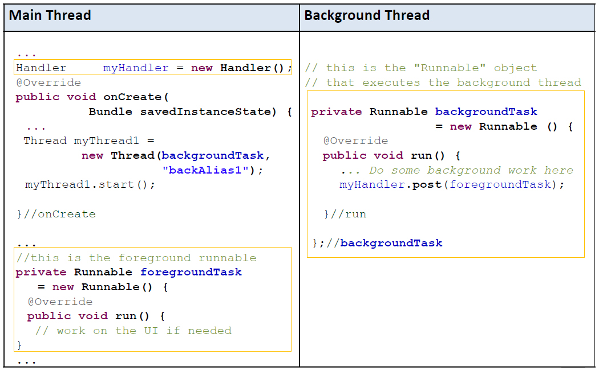
Multithreading
Using Post

Slide 19
Multithreading
Messages
To send a Message to a Handler, the thread must first invoke obtainMessage() to get the Message object out of the pool.
There are a few forms of obtainMessage(), allowing you to just create an empty Message object, or messages holding arguments
Example:
// thread 1 produces some local data
String localData= “Greeting from thread 1”;
// thread 1 requests a message & adds localDatato it
Messagemgs = myHandler.obtainMessage(1, localData);

Slide 20
Multithreading
sendMessage Methods
You deliver the message using one of the sendMessage...() family of methods, such as …
sendMessage() puts the message at the end of the queue immediately
sendMessageAtFrontOfQueue() puts the message at the front of the queue immediately (versus the back, as is the default), so your message takes priority over all others

Slide 21
Multithreading
sendMessage Methods
You deliver the message using one of the sendMessage...() family of methods, such as …
sendMessageAtTime()puts the message on the queue at the stated time, expressed in the form of milliseconds based on system uptime (SystemClock.uptimeMillis())
sendMessageDelayed() puts the message on the queue after a delay, expressed in milliseconds

Slide 22
Multithreading
Processing Messages
To process messages sent by the background threads, your Handler needs to implement the listener which will be called with each message that appears on the message queue.
handleMessage()
There, the handler can update the UI as needed. However, it should still do that work quickly, as other UI work is suspended until the Handler is done.

Slide 23
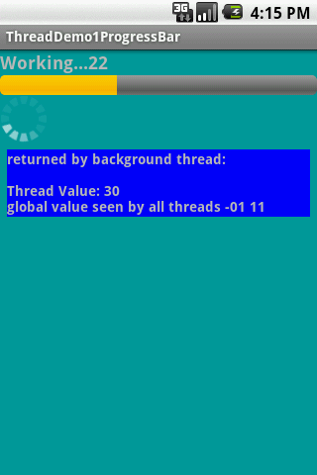
Multithreading
Example 1: Progress Bar –Using Message Passing
The main thread displays a horizontal and a circular progress bar widget showing the progress of a slow background operation.
Some random data is periodically sent from the background thread and the messages are displayed in the main view.

Slide 24
Multithreading
Example 1: Progress Bar –Using Message Passing
<?xml version="1.0" encoding="utf-8"?>
<LinearLayout
android:id="@+id/widget28"
android:layout_width="fill_parent"
android:layout_height="fill_parent"
android:background="#ff009999"
android:orientation="vertical"
xmlns:android="http://schemas.android.com/apk/res/android"
>
<TextView
android:id="@+id/TextView01"
android:layout_width="fill_parent”

Slide 25
Multithreading
Example 1: Progress Bar –Using Message Passing
android:layout_height="wrap_content"
android:text="Working ...."
android:textSize="18sp"
android:textStyle="bold" />
<ProgressBar
android:id="@+id/progress"
android:layout_width="fill_parent"
android:layout_height="wrap_content"
style="?android:attr/progressBarStyleHorizontal" />
<ProgressBar
android:id="@+id/progress2"
android:layout_width="wrap_content"
android:layout_height="wrap_content" />

Slide 26
Multithreading
Example 1: Progress Bar –Using Message Passing
<TextView
android:id="@+id/TextView02"
android:layout_width="fill_parent"
android:layout_height="wrap_content"
android:text="returned from thread..."
android:textSize="14sp"
android:background="#ff0000ff"
android:textStyle="bold"
android:layout_margin="7px"/>
</LinearLayout>
// Multi-threading example using message passing
package cis493.threads;
import java.util.Random;

Slide 27
Multithreading
Example 1: Progress Bar –Using Message Passing
import android.app.Activity;
import android.os.Bundle;
import android.os.Handler;
import android.os.Message;
import android.view.View;
import android.widget.ProgressBar;
import android.widget.TextView;
public class ThreadDemo1ProgressBar extendsActivity {
ProgressBarbar1;
ProgressBarbar2;
TextViewmsgWorking;
TextViewmsgReturned;
booleanisRunning= false;

Slide 28
Multithreading
Example 1: Progress Bar –Using Message Passing
finalintMAX_SEC= 60; // (seconds) lifetime for background thread
String strTest= "global value seen by all threads ";
intintTest= 0;
Handler handler= newHandler() {
@Override
public void handleMessage(Message msg) {
String returnedValue= (String)msg.obj;
//do something with the value sent by the background thread here ...
msgReturned.setText("returned by background thread: \n\n"
+ returnedValue);

Slide 29
Multithreading
Example 1: Progress Bar –Using Message Passing
bar1.incrementProgressBy(2);
//testing thread’s termination
if(bar1.getProgress() == MAX_SEC){
msgReturned.setText("Done \n back thread has been stopped");
isRunning= false;
}
if(bar1.getProgress() == bar1.getMax()){
msgWorking.setText("Done");
bar1.setVisibility(View.INVISIBLE);
bar2.setVisibility(View.INVISIBLE);
}
else{

Slide 30
Multithreading
Example 1: Progress Bar –Using Message Passing
msgWorking.setText("Working..."+
bar1.getProgress() );
}
}
}; //handler
@Override
public void onCreate(Bundle icicle) {
super.onCreate(icicle);
setContentView(R.layout.main);
bar1= (ProgressBar) findViewById(R.id.progress);
bar2= (ProgressBar) findViewById(R.id.progress2);
bar1.setMax(MAX_SEC);
bar1.setProgress(0);

Slide 31
Multithreading
Example 1: Progress Bar –Using Message Passing
msgWorking= (TextView)findViewById(R.id.TextView01);
msgReturned= (TextView)findViewById(R.id.TextView02);
strTest+= "-01"; // slightly change the global string
intTest= 1;
}//onCreate
public void onStop() {
super.onStop();
isRunning= false;
}
publicvoidonStart() {
super.onStart();
// bar1.setProgress(0);
Thread background = newThread(newRunnable() {

Slide 32
Multithreading
Example 1: Progress Bar –Using Message Passing
publicvoidrun() {
try{
for(inti = 0; i < MAX_SEC&& isRunning; i++) {
//try a Toast method here (will not work!)
//fake busy busywork here
Thread.sleep(1000); //one second at a time
Random rnd= newRandom();
// this is a locally generated value
String data = "Thread Value: "+ (int) rnd.nextInt(101);
//we can see and change (global) class variables
data += "\n"+ strTest+ " "+ intTest;
intTest++;

Slide 33
Multithreading
Example 1: Progress Bar –Using Message Passing
//request a message token and put some data in it
Message msg= handler.obtainMessage(1, (String)data);
// if thread is still alive send the message
if(isRunning) {
handler.sendMessage(msg);
}}
} catch(Throwablet) {
// just end the background thread
}}//run
});//background
isRunning= true;
background.start();}//onStart
} //class

Slide 34
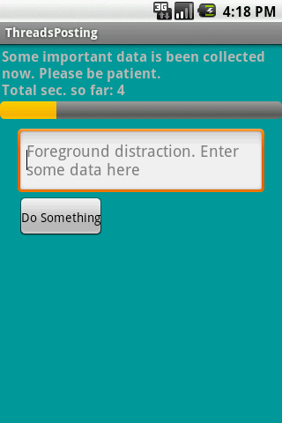
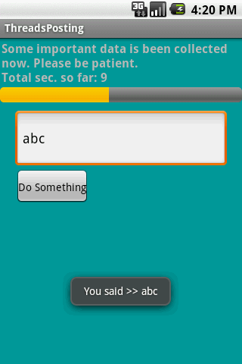
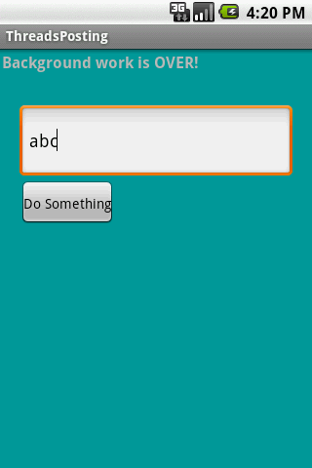
Multithreading
Example 2: Using Handler post(...) Method
We will try the same problem presented earlier (a slow background task and a responsive foreground UI) this time using the posting mechanism to execute foreground runnables.

Slide 35
Multithreading
Example 2: Using Handler post(...) Method
<?xml version="1.0" encoding="utf-8"?>
<LinearLayout
android:id="@+id/linearLayout1"
android:layout_width="fill_parent"
android:layout_height="fill_parent"
android:background="#ff009999"
android:orientation="vertical"
xmlns:android=http://schemas.android.com/apk/res/android>
<TextView
android:id="@+id/lblTopCaption"
android:layout_width="fill_parent"
android:layout_height="wrap_content”

Slide 36
Multithreading
Example 2: Using Handler post(...) Method
android:padding="2px"
android:text="Some important data is been collected now. Patience please..."
android:textSize="16sp"
android:textStyle="bold" />
<ProgressBar
android:id="@+id/myBar"
style="?android:attr/progressBarStyleHorizontal"
android:layout_width="fill_parent"
android:layout_height="wrap_content" />
<EditText
android:id="@+id/txtBox1"
android:layout_width="fill_parent”

Slide 37
Multithreading
Example 2: Using Handler post(...) Method
android:layout_height="78px"
android:layout_marginLeft="20px"
android:layout_marginRight="20px"
android:textSize="18sp" android:layout_marginTop="10px" />
<Button
android:id="@+id/btnDoSomething"
android:layout_width="wrap_content"
android:layout_height="wrap_content"
android:padding="4px"
android:layout_marginLeft="20px"
android:text="Do Something" />
</LinearLayout>

Slide 38
Multithreading
Example 2: Using Handler post(...) Method
// using Handler post(...) method to execute foreground runnables
package cis493.threads;
import android.app.Activity;
import android.os.Bundle;
import android.os.Handler;
import android.text.Editable;
import android.view.View;
import android.view.View.OnClickListener;
import android.widget.Button;
import android.widget.EditText;
import android.widget.ProgressBar;
import android.widget.TextView;

Slide 39
Multithreading
Example 2: Using Handler post(...) Method
import android.widget.Toast;
public class ThreadsPosting extends Activity {
ProgressBarmyBar;
TextViewlblTopCaption;
EditTexttxtBox1;
Button btnDoSomething;
intaccum= 0;
longstartingMills= System.currentTimeMillis();
String PATIENCE= "Some important data is been collected now. "+
"\nPleasebe patient. “;
Handler myHandler= newHandler();
@Override

Slide 40
Multithreading
Example 2: Using Handler post(...) Method
public void onCreate(Bundle savedInstanceState) {
super.onCreate(savedInstanceState);
setContentView(R.layout.main);
lblTopCaption= (TextView)findViewById(R.id.lblTopCaption);
myBar= (ProgressBar) findViewById(R.id.myBar);
myBar.setMax(100);
txtBox1= (EditText) findViewById(R.id.txtBox1);
txtBox1.setHint("Foreground distraction. Enter some data here");
btnDoSomething= (Button)findViewById(R.id.btnDoSomething);
btnDoSomething.setOnClickListener(newOnClickListener() {

Slide 41
Multithreading
Example 2: Using Handler post(...) Method
@Override
public void onClick(View v) {
Editable txt = txtBox1.getText();
Toast.makeText(getBaseContext(), "You said >> "+ txt, 1).show();
}//onClick
});//setOnClickListener
}//onCreate
@Override
protectedvoidonStart() {
super.onStart();
// create background thread were the busy work will be done

Slide 42
Multithreading
Example 2: Using Handler post(...) Method
Thread myThread1 = newThread(backgroundTask, "backAlias1");
myThread1.start();
myBar.incrementProgressBy(0);
}
// this is the foreground "Runnable" object responsible for GUI updates
private RunnableforegroundTask= newRunnable() {
@Override
publicvoidrun() {
try{
intprogressStep= 5;
lblTopCaption.setText(PATIENCE+ "\nTotalsec. so far:

Slide 43
Multithreading
Example 2: Using Handler post(...) Method
"+
(System.currentTimeMillis() -startingMills) / 1000 );
myBar.incrementProgressBy(progressStep);
accum+= progressStep;
if(accum>= myBar.getMax()){
lblTopCaption.setText("Background work is OVER!");
myBar.setVisibility(View.INVISIBLE);
}
} catch(Exception e) {
e.printStackTrace();
}
}//run
}; //foregroundTask

Slide 44
Multithreading
Example 2: Using Handler post(...) Method
//this is the "Runnable" object that executes the background thread
privateRunnablebackgroundTask= newRunnable() {
@Override
publicvoidrun() {
//busy work goes here...
try{
for(intn=0; n<20; n++) {
//this simulates 1 sec. of busy activity
Thread.sleep(1000);
//now talk to the main thread
myHandler.post(foregroundTask);
}

Slide 45
Multithreading
Example 2: Using Handler post(...) Method
} catch(InterruptedExceptione) {
e.printStackTrace();
}
}//run
};//backgroundTask
}//ThreadsPosting

Slide 46
Multithreading
Thread States
Object.notify() or Object.notifyAll()
Waiting
Object.notify() or Object.notifyAll()
Sleeping
Chosen by schduler
Thread.sleep();
read-to-run()
Start()
Schedule swap/ Threadyield()
Stop(), or run() exits
Running
object.wate()
done
Blocks for IO Or Enters synchronized code
Dead
Data received Or Lock obtained
Blocked
Another thread closes IO socket
Android‘s threads run in a manner similar to common Java threads

Slide 47
Multithreading
Thread States
Thread.State | Description
BLOCKED | The thread is blocked and waiting for a lock.
NEW | The thread has been created, but has never been started.
RUNNABLE | The thread may be run.
TERMINATED | The thread has been terminated.
TIMED_WAITING | The thread is waiting for a specified amount of time.
WAITING | The thread is waiting.

Slide 48
Multithreading
Using The AsyncTask Class
AsyncTask enables proper and easy use of the UI thread.
This class allows to perform background operations and publish results on the UI thread without having to manipulate threads and/or handlers.
An asynchronous task is defined by a computation that runs on a background thread and whose result is published on the UI thread.

Slide 49
Multithreading
Using The AsyncTask Class
An asynchronous task is defined by 3 generic types, 4 operational steps, and 1 auxiliary method, they are:
Generic Types
Operational Steps
Auxiliary Method
begin
Params
doInBackground
Progress
publicProgress
processProgress
Result
end

Slide 50
Multithreading
Using The AsyncTask Class
private class VerySlowTaskextendsAsyncTask<String, Long, Void> {// Begin -can use UI thread here
protectedvoidonPreExecute() {
}// this is the SLOW background thread taking care of heavy tasks
// cannot directly change UI
protected Void doInBackground(finalString... args) {
... publishProgress((Long) someLongValue);
}// periodic updates -it is OK to change UI
@Override
protected void onProgressUpdate(Long... value) {
}// End -can use UI thread here
protected void onPostExecute(finalVoid unused) {}}

Slide 51
Multithreading
Using The AsyncTask Class
AsyncTask <Params, Progress, Result>
AsyncTask's Generic Types
Params | the type of the parameters sent to the task upon execution.
Progress | the type of the progress units published during the background computation.
Result | the type of the result of the background computation.
Not all types are always used by an asynchronous task. To mark a type as unused, simply use the type Void
Note:
Syntax “String…” indicates array of String values, similar to “String*+”

Slide 52
Multithreading
AsyncTask Methods
onPreExecute()
Invoked on the UI thread immediately after the task is executed. This step is normally used to setup the task, for instance by showing a progress bar in the user interface.

Slide 53
Multithreading
AsyncTask Methods
doInBackground(Params...)
Invoked on the background thread immediately after onPreExecute() finishes executing. This step is used to perform background computation that can take a long time. The parameters of the asynchronous task are passed to this step. The result of the computation must be returned by this step and will be passed back to the last step. This step can also use publishProgress(Progress...) to publish one or more units of progress. These values are published on the UI thread, in the onProgressUpdate(Progress...) step.

Slide 54
Multithreading
AsyncTask Methods
onProgressUpdate(Progress...)
Invoked on the UI thread after a call to publishProgress(Progress...). The timing of the execution is undefined. This method is used to display any form of progress in the user interface while the background computation is still executing. For instance, it can be used to animate a progress bar or show logs in a text field.

Slide 55
Multithreading
AsyncTask Methods
onPostExecute(Result)
Invoked on the UI thread after the background computation finishes. The result of the background computation is passed to this step as a parameter.

Slide 56
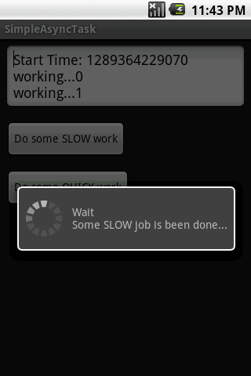
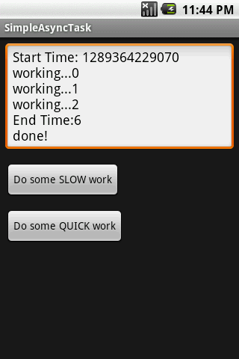
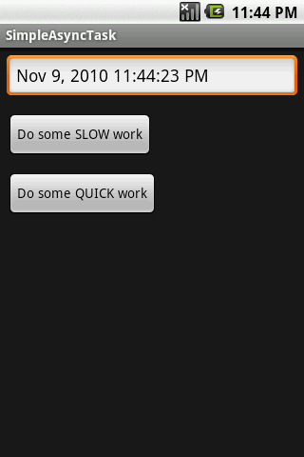
Multithreading
Example: Using The AsyncTask Class
The main task invokes an AsyncTask to do some slow job. The AsyncTask methods do the required computation and periodically update the main’s UI. In our the example the background activity negotiates the writing of the lines in the text box, and also controls the circular progress bar.

Slide 57
Multithreading
Example: Using The AsyncTask Class
public class Main extends Activity {
Button btnSlowWork;
Button btnQuickWork;
EditTextetMsg;
Long startingMillis;
@Override
public void onCreate(Bundle savedInstanceState) {
super.onCreate(savedInstanceState);
setContentView(R.layout.main);
etMsg= (EditText) findViewById(R.id.EditText01);
btnSlowWork= (Button) findViewById(R.id.Button01);
// delete all data from database (when delete button is clicked)

Slide 58
Multithreading
Example: Using The AsyncTask Class
this.btnSlowWork.setOnClickListener(newOnClickListener() {
public void onClick(finalView v) {
newVerySlowTask().execute();
}
});
btnQuickWork= (Button) findViewById(R.id.Button02);
// delete all data from database (when delete button is clicked)
this.btnQuickWork.setOnClickListener(newOnClickListener() {
public void onClick(finalView v) {
etMsg.setText((newDate()).toLocaleString());

Slide 59
Multithreading
Example: Using The AsyncTask Class
}
});
}// onCreate
private class VerySlowTask extends AsyncTask<String, Long, Void> {
private finalProgressDialogdialog= newProgressDialog(Main.this);
// can use UI thread here
protected void onPreExecute() {
startingMillis= System.currentTimeMillis();
etMsg.setText("Start Time: "+ startingMillis);
this.dialog.setMessage("Wait\nSomeSLOW job is been done...");

Slide 60
Multithreading
Example: Using The AsyncTask Class
this.dialog.show();
}
// automatically done on worker thread (separate from UI thread)
protected void doInBackground(finalString... args) {
try{
// simulate here the slow activity
for(Long i = 0L; i < 3L; i++) {
Thread.sleep(2000);
publishProgress((Long)i);
}
} catch(InterruptedExceptione) {
Log.v("slow-job being done", e.getMessage())

Slide 61
Multithreading
Example: Using The AsyncTask Class
}
returnnull;
}
// periodic updates -it is OK to change UI
@Override
protected void onProgressUpdate(Long... value) {
super.onProgressUpdate(value);
etMsg.append("\nworking..."+ value[0]);
}
// can use UI thread here
protected void onPostExecute(finalVoid unused) {
if(this.dialog.isShowing()) {
this.dialog.dismiss();

Slide 62
Multithreading
Example: Using The AsyncTask Class
}
// cleaning-up all done
etMsg.append("\nEndTime:"
+ (System.currentTimeMillis()-startingMillis)/1000);
etMsg.append("\ndone!");
}
}//AsyncTask
}// Main
<?xml version="1.0" encoding="utf-8"?>
<LinearLayoutxmlns:android="http://schemas.android.com/apk/res/android"
android:orientation="vertical"
android:layout_width="fill_parent”

Slide 63
Multithreading
Example: Using The AsyncTask Class
android:layout_height="fill_parent"
>
<EditText
android:id="@+id/EditText01"
android:layout_width="fill_parent"
android:layout_height="wrap_content"
android:layout_margin="7px" />
<Button
android:text="Do some SLOW work"
android:id="@+id/Button01"
android:layout_width="wrap_content"
android:layout_height="wrap_content"
android:layout_margin="7px" />

Slide 64
Multithreading
Example: Using The AsyncTask Class
<Button
android:text="Do some QUICK work"
android:id="@+id/Button02"
android:layout_width="wrap_content"
android:layout_height="wrap_content"
android:layout_margin="7px" />
</LinearLayout>

